Slide 1

Swiggy Restaurant Recommender System
by
Subbu Murugappan
AIML Propject

Slide 2
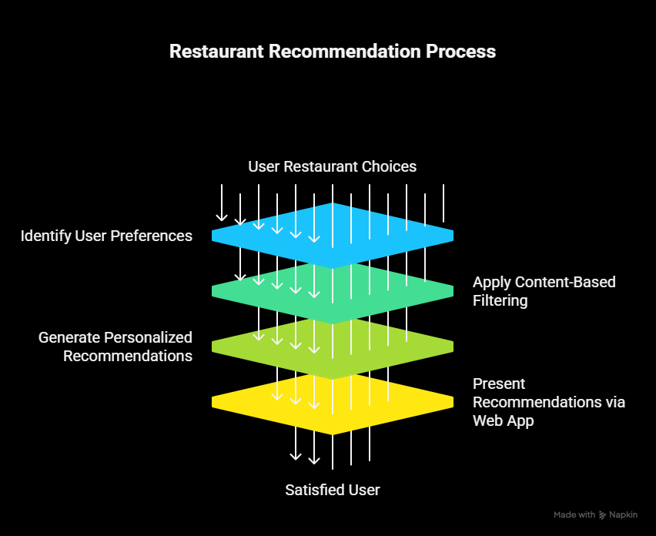


Slide 3
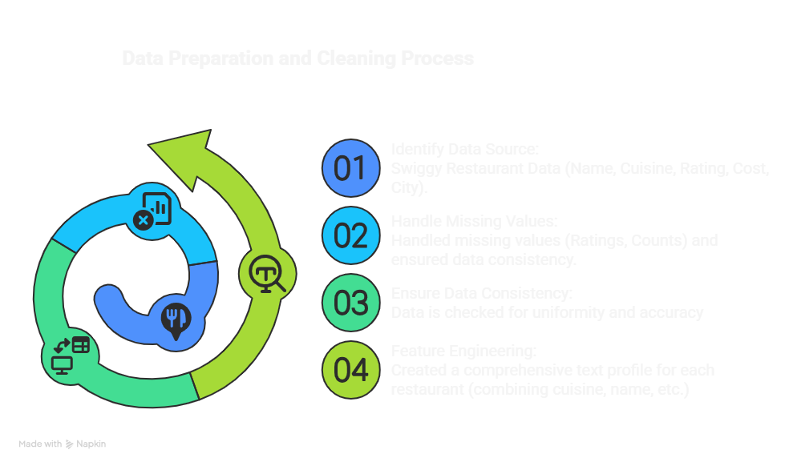

Slide 4
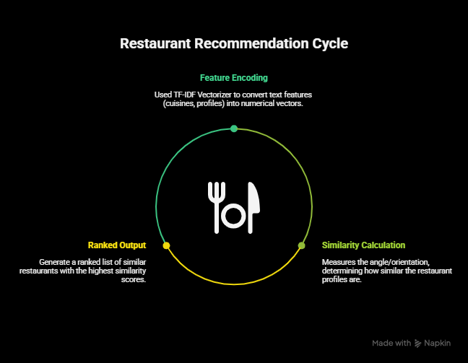

Slide 5
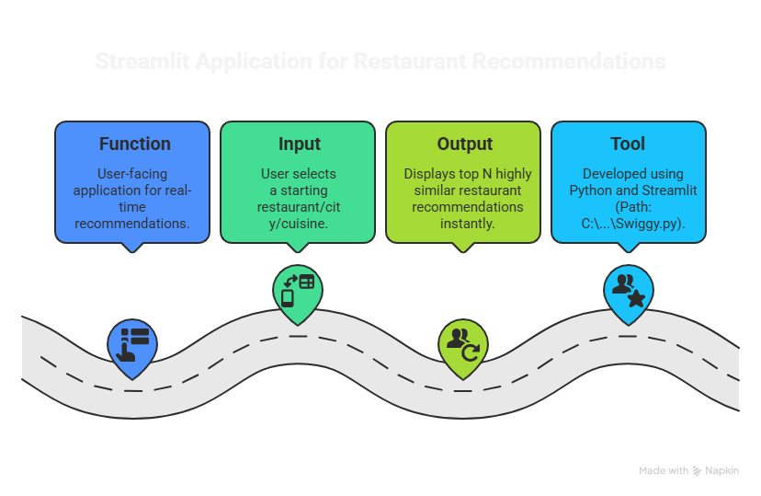


Slide 6
